Slide 1
Web Application Overview
Raj Krishnan

Slide 2
The Web Browser
Send Request to Web Browser
Resolve DNS Address, Use Http to connect to the server and request a page
Server Authentication (SSL)
Process Response (HTML, images, video, animation, error, redirection …)
Display HTML and embedded objects
Run Client Scripts

Slide 3
HTTP Status Code
1xx – Informational
2xx –Success
3xx – Redirect
4xx – Client Error
5xx – Server Error
Monitoring web traffic – Fiddler; Developer tools F12

Slide 4
Creating Web Site
New Web Site – File, FTP and HTTP
Web Site VS Web Application
WEB Application | Web Site
A project file is created with information about files and references | No project file is created
Compile using tools and an assembly is created | Dynamic compilation and multiple assemblies
Namespace added | Add Manually
Compile application and copy assembly to server; use tools for web deploy | copy the application source files to a computer that has IIS installed on it.

Slide 5
Web Config File
Configuration level | File name | File description
Server | Machine.config | contains the ASP.NET schema for all of the Web applications on the server
Root Web | Web.config | The Web.config file for the server is stored in the same directory as the Machine.config file and contains default values for most of the system.web configuration sections. this file is merged second from the top in the configuration hierarchy.
Web site | Web.config | for a specific Web site
ASP.NET application root directory | Web.config | The Web.config file for a specific ASP.NET application is located in the root directory of the application and contains settings that apply to the Web application
ASP.NET application subdirectory | Web.config | The Web.config file for an application subdirectory contains settings that apply to this subdirectory

Slide 6
Tools and Techniques

Slide 7
Type of Application
Web Forms
MVC
Web Api
Single page Application
Azure Mobile Services
Empty

Slide 8
Web Forms
Familiar control and event based programming model
Controls encapsulate HTML 5, CSS and JS
Rich UI Controls – data grids, charts, Ajax
Browser variations handled for you
Programming model – UI Controls and wiring event handlers

Slide 9
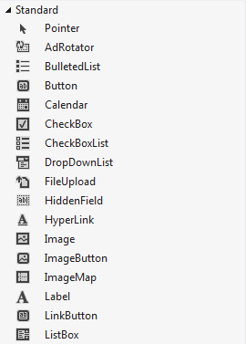
Web Forms
Rich Server Controls
View State Support

Slide 10
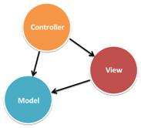
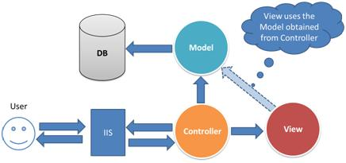
MVC
Total control of HTML
Supports TDD, unit testing
Flexible and extensible

Slide 11
Web Forms Vs MVC
ASP.NET Web Forms | ASP.NET MVC
ASP.NET Web Forms uses Page controller pattern approach for rendering layout. In this approach, every page has it’s own controller i.e. code-behind file that processes the request. | ASP.NET MVC uses Front Controller approach. That approach means ,a common controller for all pages, processes the requests.
No separation of concerns. Every page (.aspx) has it’s own controller (code behind i.e. aspx.cs/.vb file), so both are tightly coupled. | Very clean separation of concerns. View and Controller are neatly separate.
Because of this coupled behavior, automated testing is really difficult. | Testability is key feature in ASP.NET MVC. Test driven development is quite simple using this approach.
In order to achieve stateful behavior, viewstate is used. Purpose was to give developers, the same experience of a typical WinForms application. | ASP.NET MVC approach is stateless as that of the web. So here no concept of viewstate.
Statefulness has a lots of problem for web environment in case of excessively large viewstate. Large viewstate means increase in page size. | As controller and view are not dependent and also no viewstate concept in ASP.NET MVC, so output is very clean.

Slide 12
We Forms Vs MVC
ASP.NET Web Forms | ASP.NET MVC
ASP.NET WebForms model follows a Page Life cycle. | No Page Life cycle like WebForms. Request cycle is simple in ASP.NET MVC model.
Along with statefulness, microsoft tries to introduce server-side controls as in Windows applications. Purpose was to provide somehow an abstraction to the details of HTML. In ASP.NET Web Forms, minimal knowledge of HTML, JavaScript and CSS is required. | In MVC, detailed knowledge of HTML, JavaScript and CSS is required.
Above abstraction was good but provides limited control over HTML, JavaScript and CSS which is necessary in many cases. | Full control over HTML, JavaScript and CSS.
With a lots of control libraries availability and limited knowledge of other related technologies, ASP.NET WebForms is RAD(Rapid Application Development) approach. | It’s a step back. For developers decrease in productivity.
It’s good for small scale applications with limited team size. | It’s better as well as recommended approach for large-scale applications where different teams are working together.

Slide 13
Web Api – Rest based services
An application programming interface to a defined request – response system typically expressed in JSON or XML
ASP.NET Web API - a framework for building web APIs on top of the .NET Framework
Inside web api 2 http://www.asp.net/media/4071077/aspnet-web-api-poster.pdf

Slide 14
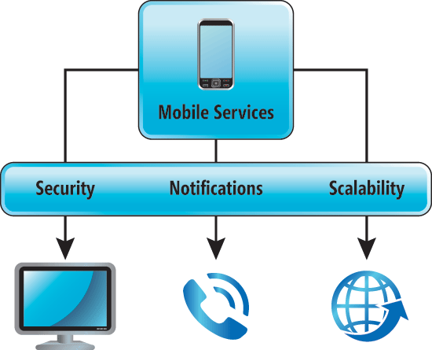
Azure Mobile Services
Simple provisioning and management of tables for storing app data.
Integration with notification services to deliver push notifications to your app.
Integration with well-known identity providers for authentication.
Granular control for authorizing access to tables.
Insertion of business logic into data access operations.
Integration with other cloud services.
Supports the ability to scale a mobile service instance.
Service monitoring and logging
Extend your backend capabilities with third-party packages and resources.
http://msdn.microsoft.com/en-us/library/azure/dn281892.aspx

Slide 15
Summary
Empty Web Application
bare minimum folders and files for an ASP.NET web site, Support for Web Forms, MVC, and/or Web API cm be added
no authentication options are available.
Web Forms Template
A WYSIWYG designer in Visual Studio.
Server controls that render HTML and that you can customize by setting properties and styles.
A rich assortment of controls for data access and data display.
An event model that exposes events which you can program like you would program a client application such as WPF.
Automatic preservation of state (data) between HTTP requests.

Slide 16
Summary
Web API Template
Creates a sample web service based on Web API, including API help pages based on MVC.
Creates a sample web service
Single Page Application Template
a sample application that uses JavaScript, HTML 5, and KnockoutJS on the client, and ASP.NET Web API on the server with Individual User Accounts.

Slide 17
Web Forms Application

Slide 18
Web Forms Application

Slide 19
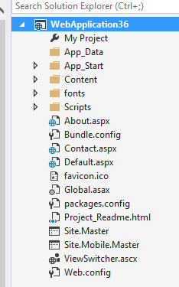
Project Structure
My Project
Project Properties
App_Data
App_Data - A storage point for file-based data store
Not viewable by the web web app stores and reads data from

Slide 20
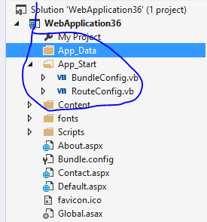
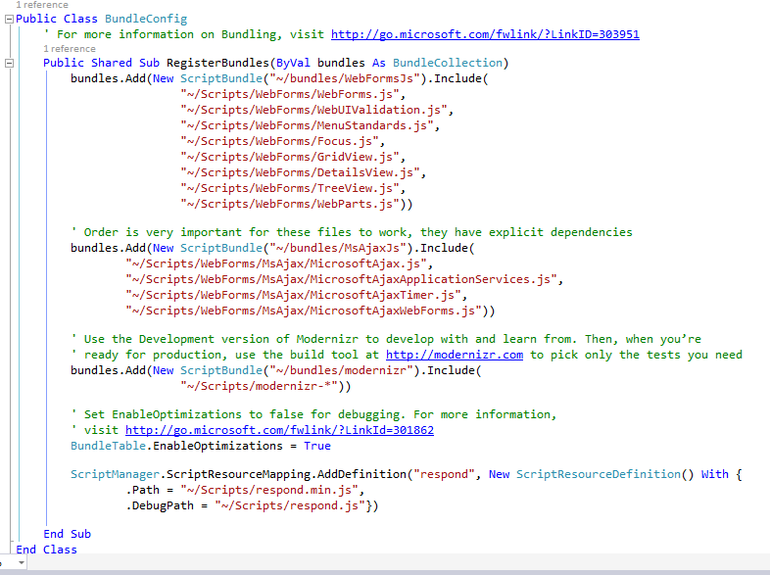
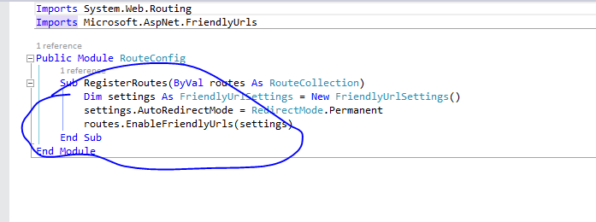
Project Structure
App_Start
BundleConfig
RouteConfig

Slide 21
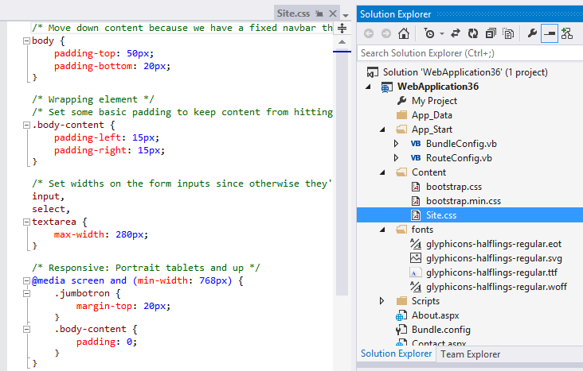
Project Structure
BootStrap
Site
Fonts
http://bootswatch.com/

Slide 22
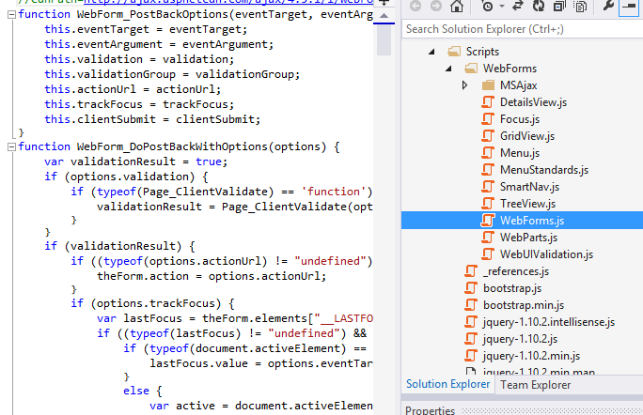
Project Structure
Scripts

Slide 23
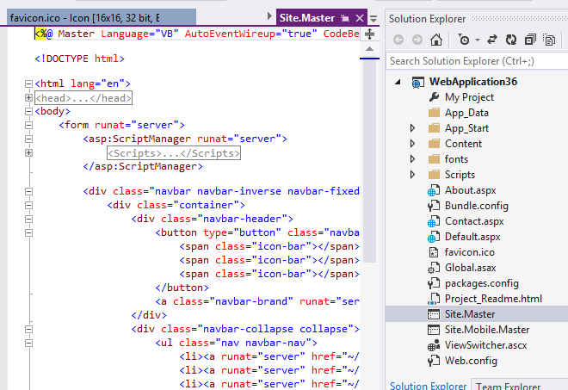
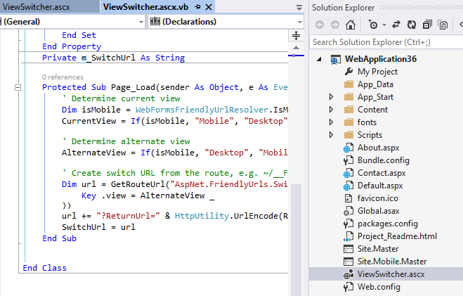
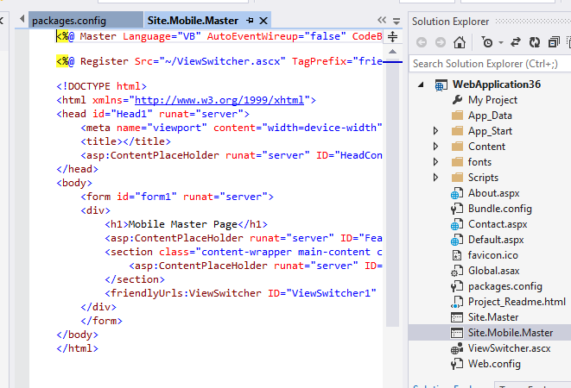
Project Structure
Site Masters / Mobile
Viewswitcher

Slide 24
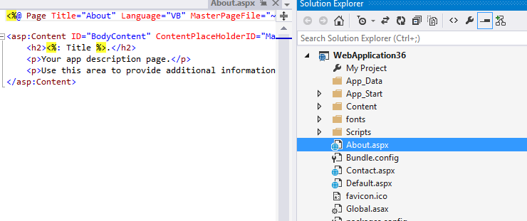
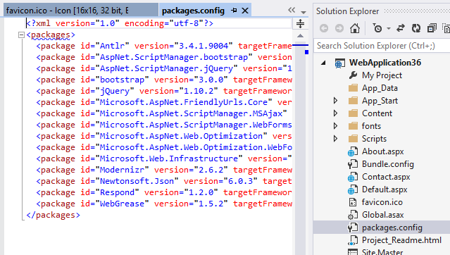
Project Structure
Default aspx pages
Global.asax
Packages

Slide 25
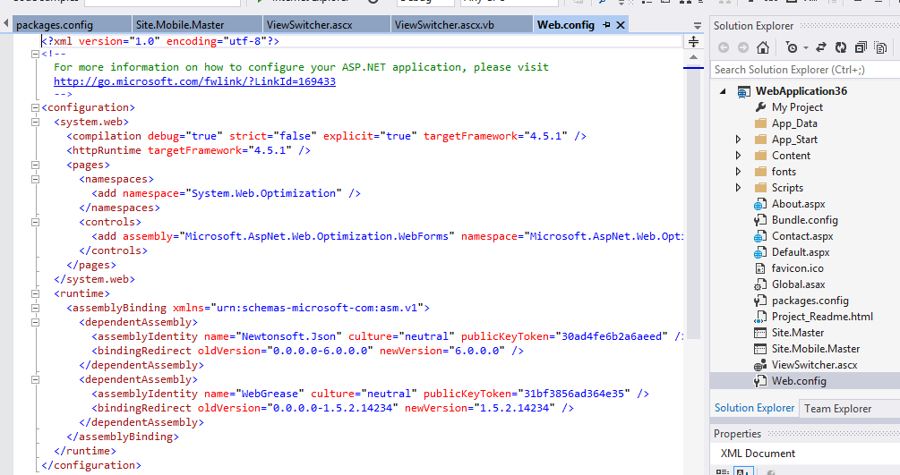
Project Structure
WebConfig

Slide 26
Basic Web Forms

Slide 27
WEB Forms
Master Pages
Content – Style Sheet
Themes (Demo) (Demo2)
Caching – Page caching, Data Caching (Demo)
Globalization (Demo)

Slide 28
Tracking sessions
Application state - stores variables that can be accessed by all users of an ASP.NET application
Profile properties which persists user values in a data store without expiring them (ASP.NET Membership)
ASP.NET caching - in memory that is available to all ASP.NET applications
View state persists values in a page.
Cookies
a small bit of text that accompanies requests and pages as they go between the Web server and browser – Size, Security limitations
The query string and fields on an HTML form that are available from an HTTP request.
Session State – user specific data (InProc, Cache / SQL)

Slide 29
State Management
Preserve data - per-page basis and an application-wide
Client side
Hidden Field - standard HTML hidden field to store page specifc information
View State - dictionary object for retaining values between multiple requests for the same page
Cookies A cookie is a small amount of data that is stored either in a text file on the client file system or in-memory in the client browser session
Control State - persist property information that is specific to a control
Query Strings - A query string is information that is appended to the end of a page URL http://www.contoso.com/listwidgets.aspx?category=basic&price=100
Server side
Session - Session state is structured as a key/value dictionary for storing session-specific information that needs to be maintained between server round trips and between requests for pages
Application - a global storage mechanism that is accessible from all pages in the Web application

Slide 30
Page Life Cycle Events (review)
Leverage Application / Page Cycle Events
Application_Start (Demo – Application Level Data)
Page_Load (Demo Page_Load / DropDown PostBack event)
ViewState
Store user specific data between requests and response
Part of every asp.net page
Client side – Hidden Field, Cookies, Query String
Server Side – Application / Session

Slide 31
WEB Forms
Server Controls (run at server)
Event Handlers
Calendar control
Style Sheet, Properties
Refactoring
Demo

Slide 32
Web Forms and JavaScript
AJAX
Jquery
Juice
http://www.asp.net/ajax
http://juiceui.com/controls - Using JQuery UI with Web forms

Slide 33
Additional Content
http://juiceui.com/controls - Using JQuery UI with Web forms

